Slide 1
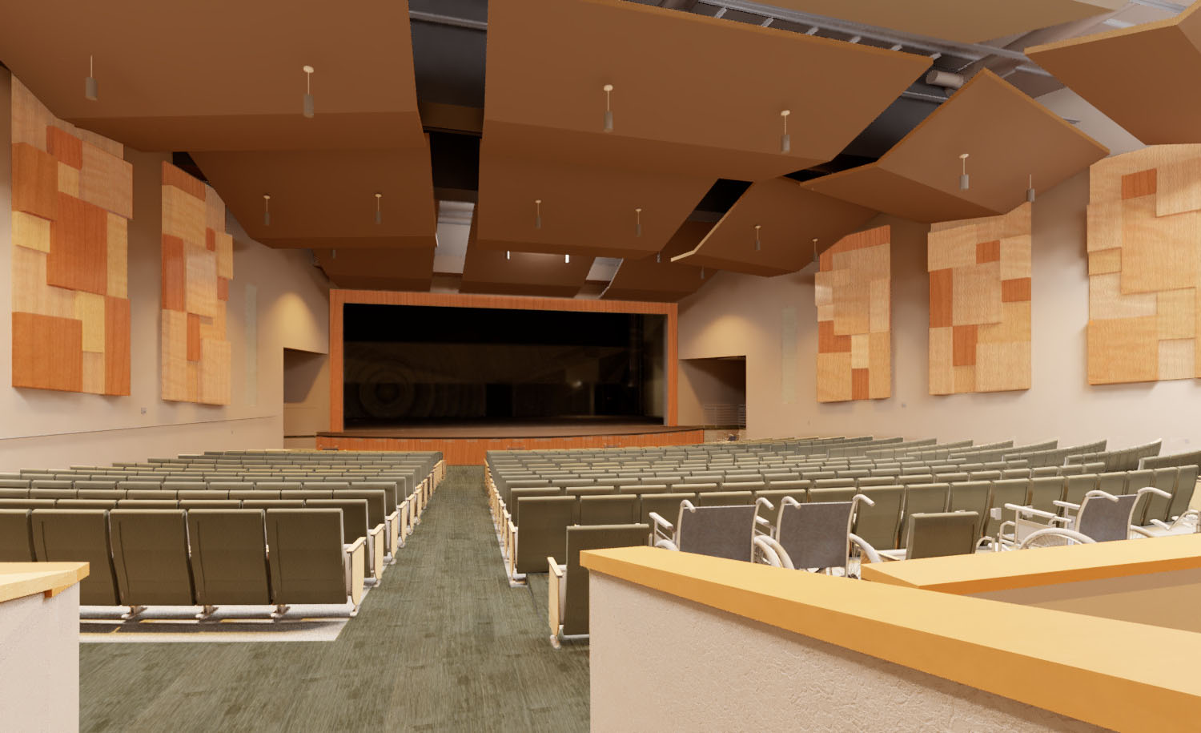
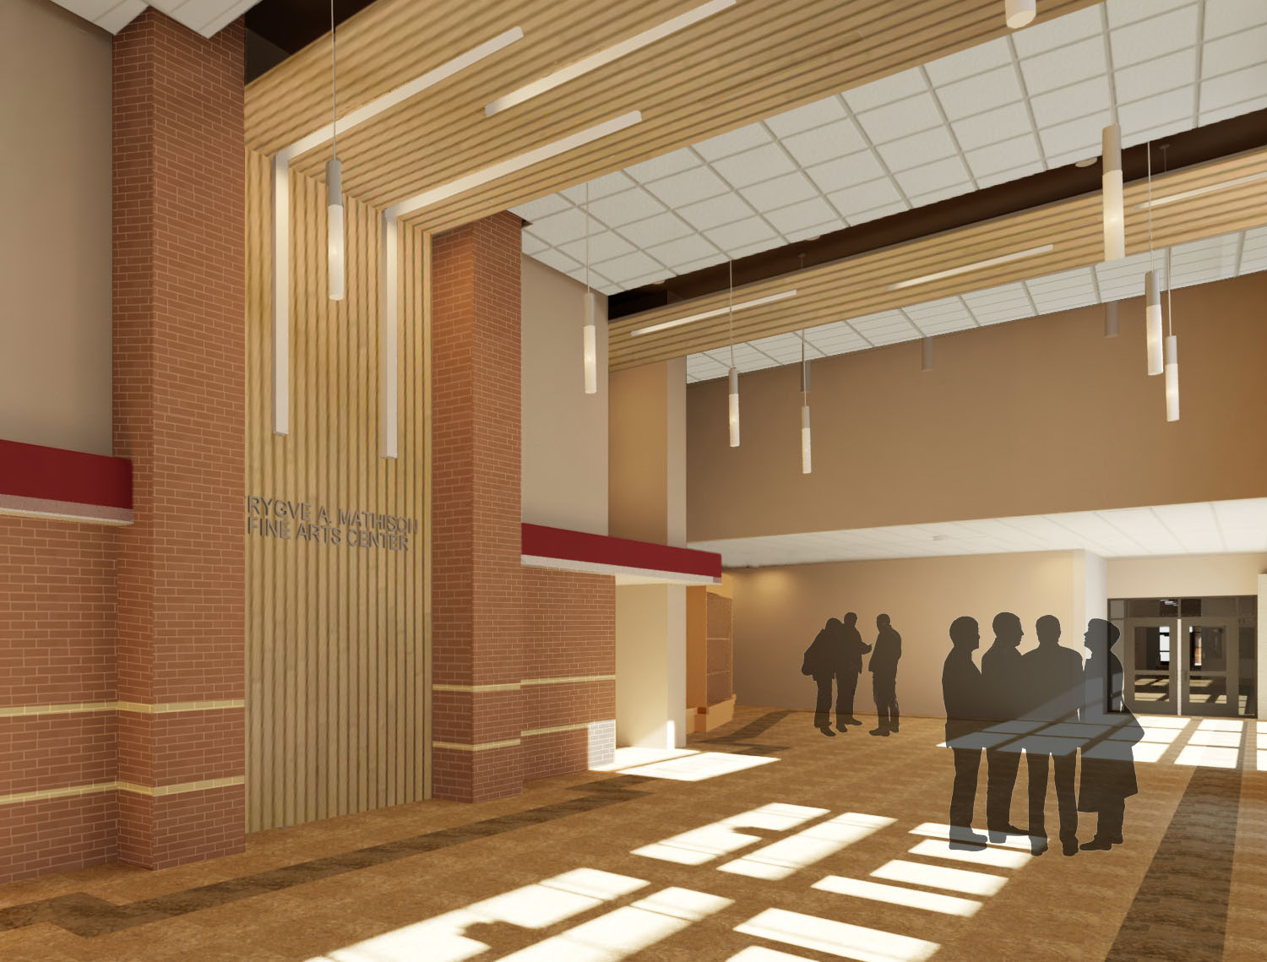
Project Update – High School Additions & Remodeling
School District of Holmen
Holmen, Wisconsin 7.22.19

Slide 2
Timeline – Phase 1 – Bid Package #2
Dec 2018/Jan 2019
Schematic Design - Addition
Jan/Feb/Mar2019:
Design Development - Addition
April/May/
June 2019:
Development of Construction Documents
(plans/
specs)
July 16, 2019:
Bidding
Documents
Released
August 2019:
State
Approval
August 12, 2019:
Board Approve Bid
August 19,
2019:
Project Begins
August 2020:
Projected Project Completion

Slide 3
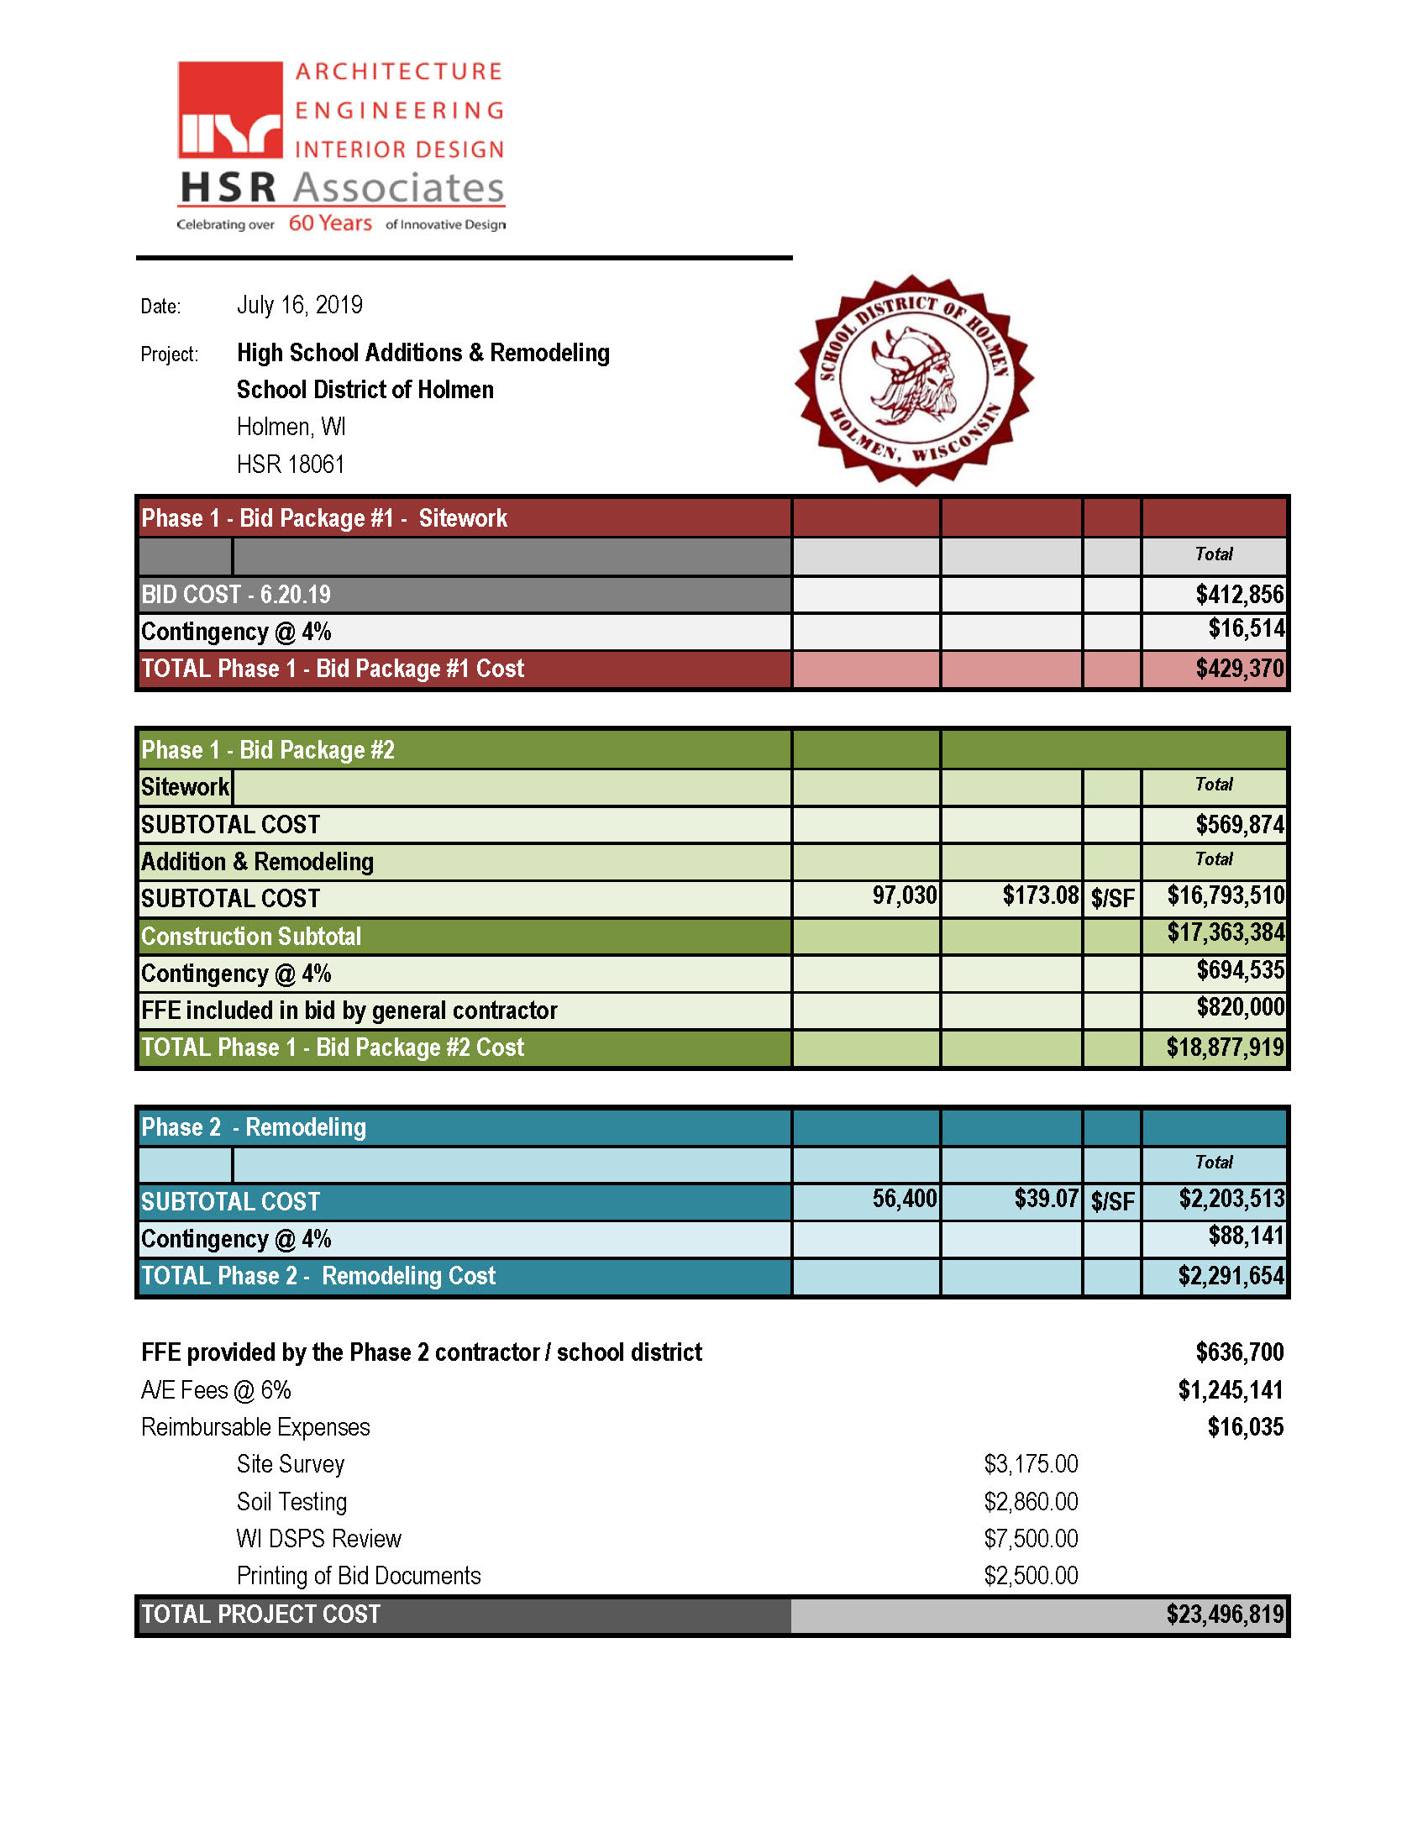
Budget – Phase 1 – Bid Package #2
Notes:
As we review the current design, this is a reminder of what the referendum materials stated.

Slide 4
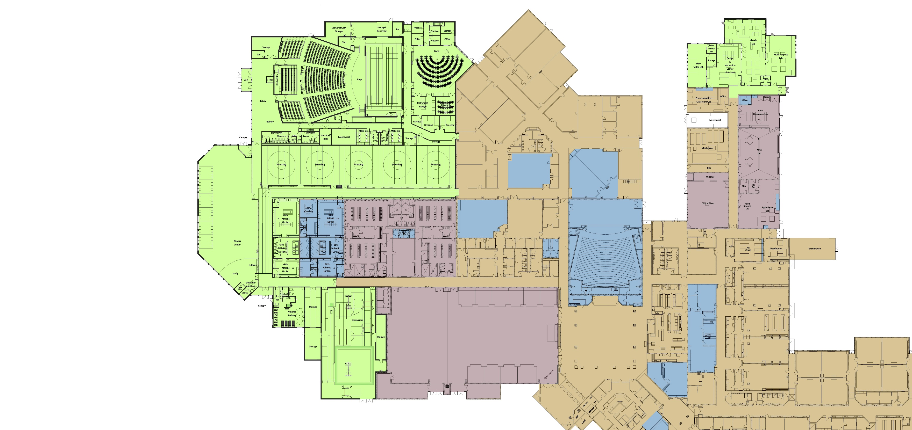
Design – Partial Overall Floor Plan
PH 1
CTE
PH 1
FAC
PH 1
Band
PH 1
Wrestling
PH 1
HVAC
PH 2
PH 2
PH 1
HVAC
PH 1
Fitness
PH 2
PH 1
Lkr Rms
PH 2
HVAC
PH 2
PH 1
Training
Existing Gymnasiums
PH 2
HVAC
PH 2
Kitchen
PH 1
Kitchen
PH 1
Gymnastics
Existing
Commons
PH 2

Slide 5
Design – Fine Arts Center Lobby

Slide 6
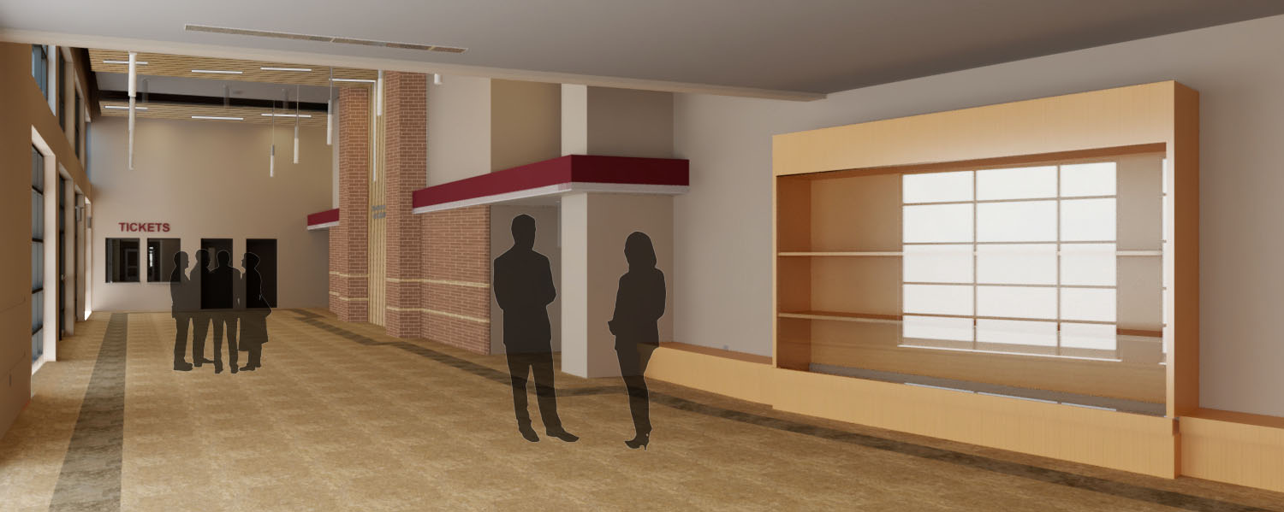
Design – Fine Arts Center Lobby

Slide 7
Design – Fine Arts Center Interior

Slide 8
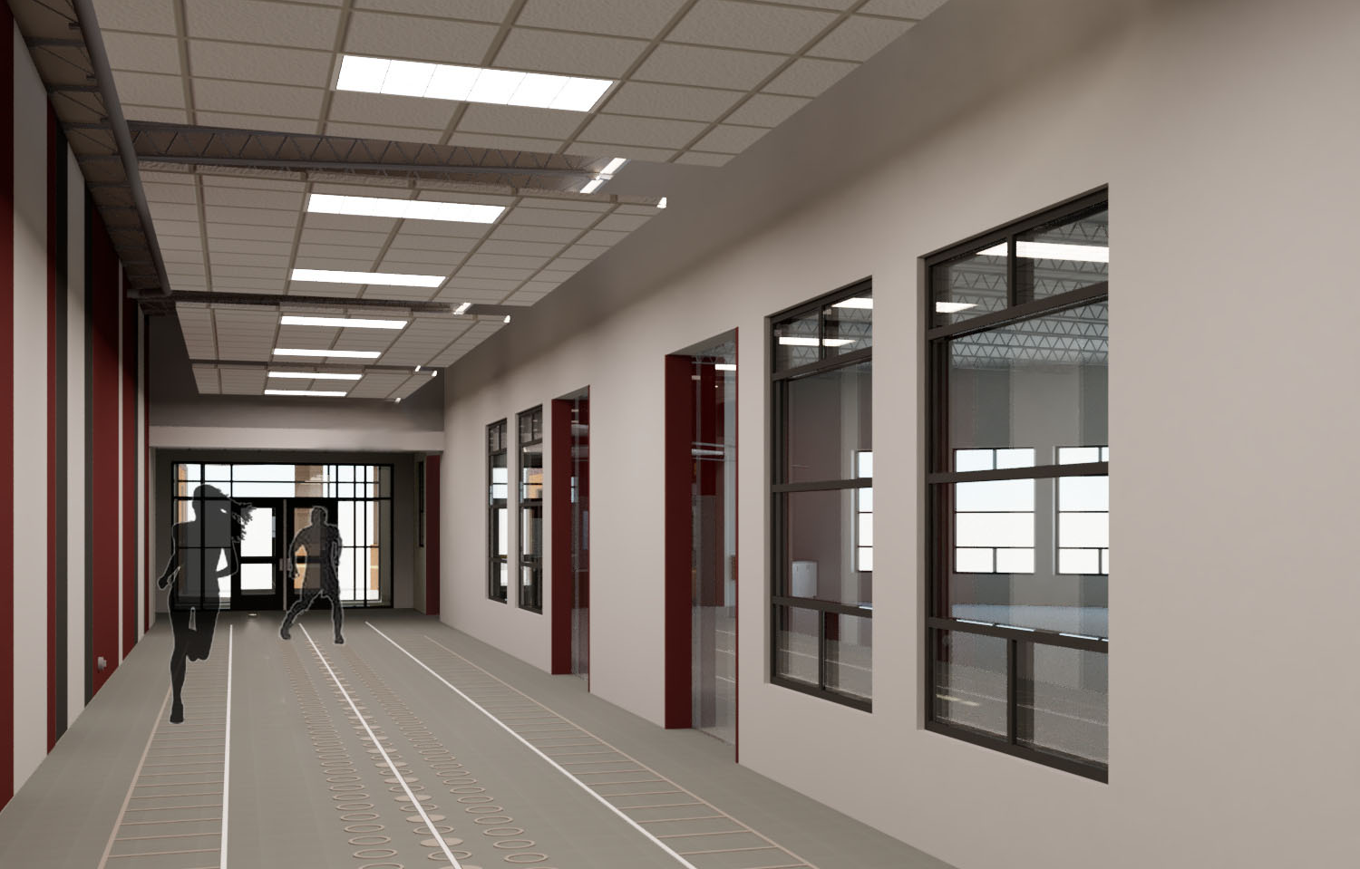
Design – Hallway Outside Fitness Center

Slide 9
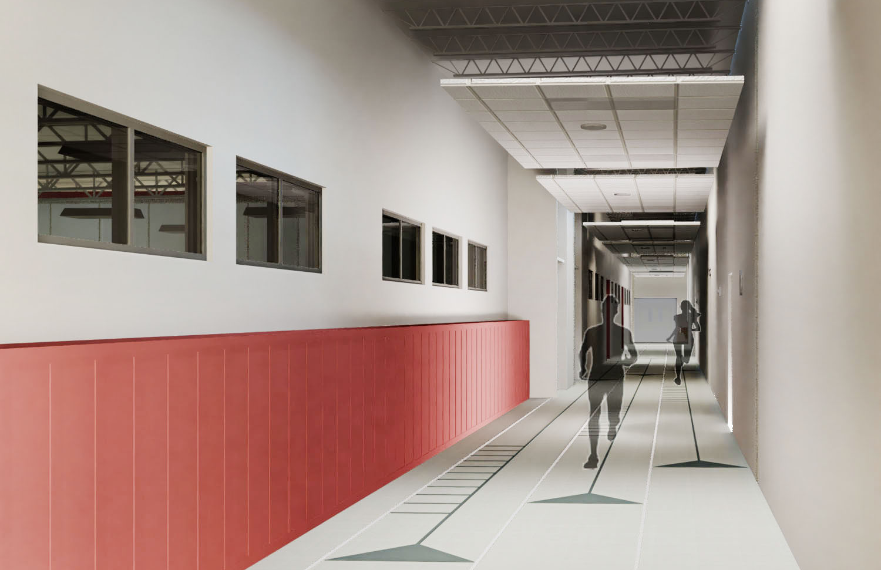
Design – Hallway Outside Wrestling Room

Slide 10
Design – Fitness Center

