Slide 1
Skeletal Muscle Pairs
Muscular System

Slide 2
Biceps and Triceps
Muscle Pairs
Movement
Bending and straightening the elbow
Triceps
Biceps

Slide 3
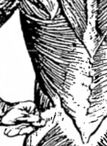
Deltoids and Latissimus Dorsi
Muscle Pairs
Movement
Deltoid
Latissimus Dorsi
lifting the arm and lowering the arm

Slide 4
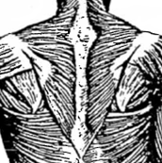
Pectorals and Trapezius
Muscle Pairs
Movement
moving the arms/shoulders forward and backward (arms are held horizontal and shoulder high for this movement)
Pectorals
Trapezius

Slide 5
Abdominals and Erector Spinae
Muscle Pairs
Movement
bending the spine forward and backward
Abdominals
Erector Spinae
**Under Latissimus Dorsi

Slide 6
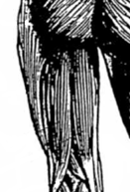
Quadriceps and Hamstrings
Muscle Groups
Movement
Quadriceps
straightening and bending of the knee
Hamstrings

Slide 7
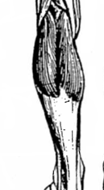
Gastrocnemius and Tibialis Anterior
Muscle Pairs
Movement
standing on or pointing your toes or pulling your toes up toward your shin
Tibialis Anterior
Gastrocnemius

Slide 8
Skeletal Muscle (Individual)
Muscular System

Slide 9
Gluteus Maximus
Muscle Location
Movement
Involved with rotation and extension of the thigh

Slide 10
Sartorius
Muscle Location
Movement
Assists in flexing, abduction and lateral rotation of hip, and flexion of knee
The longest muscle of your body

Slide 11
Skeletal Muscle (Tendon)

Slide 12
Achilles' Tendon
Location
Function
Thick white cord, which attaches the gastrocnemius to the tarsal (heel bone) .
Used for assisting gastrocnemius to straighten foot (walking, running, jumping, etc.)

